Slide 1
Data and Computer Communications
Tenth Edition
by William Stallings
Notes:
“Data and Computer Communications”, 10/e, by William Stallings, Chapter 21 “Internetwork Operation”

Slide 2
Internetwork Operation
Chapter 21
Chapter 22
Internetwork Quality of Service
Summary
Notes:
This chapter begins with a discussion of multicasting. Next we look at a new
approach to managing Internet traffic known as software-defined network
(SDN), and the related protocol OpenFlow. The chapter then introduces the
topic of Mobile IP. Refer to Figure 21.8 to see the position within the TCP/IP
suite of the protocols discussed in this chapter.

Slide 3
Outline
Multicasting
Software Defined Network (SDN)
Mobile IP (MIP)
Internet QoS
Notes:
Multicasting done within the scope of a single LAN segment is straightforward. IEEE 802 and other LAN protocols include provision for MAC-level multicast addresses. A packet with a multicast address is transmitted on a LAN segment. Those stations that are members of the corresponding multicast group recognize the multicast address and accept the packet. In this case, only a single copy of the packet is ever transmitted. This technique works because of the broadcast nature of a LAN: a transmission from any one station is received by all other stations on the LAN.

Slide 4
Multicasting-1
S
S
R1
R1
R2
R3
R2
R3
m1
m2
m3
m1
m2
m3
Multiple Unicast
True Multicast
(IP Multicast)

Slide 5
Multicasting-2
Element-1: Group ID (IP Multicast Address)
Element-2: Group Membership Management (IGMP)
Element-3: Multicast Routing Protocols
S
R1
Multicast Routing Protocol
R1
R4
R3
IGMP
IGMP
IGMP
m1
m3
m2

Slide 6
Multicasting-3
Multicast Routing Tree
Source-based Tree
Group Shared Tree
S1
S2
S1
S2
m1
m2
m3
m1
m2
m3
E.g. DVMRP, MOSPF
E.g. CBT

Slide 7
Evolving Network Requirements
Increasingly widespread use of server virtualization
  Makes it possible to partition a single machine into multiple independent servers, conserving h/w resources
  Also for load balancing or for dynamic switchover in the case of machine failure
  A central element in dealing with “big data” applications and in implementing cloud computing infrastructures
Increasing use by employees of mobile devices, such as smartphones, tablets, and notebooks to access enterprise resources
  Network managers must be able to respond to rapidly changing resource, QoS, and security requirements
Notes:
One key driving factor is the increasingly widespread use of server virtualization.
In essence, server virtualization masks server resources, including the number
and identity of individual physical servers, processors, and operating systems, from
server users. This makes it possible to partition a single machine into multiple independent
servers, conserving hardware resources. It also makes it possible to quickly
migrate a server from one machine to another for load balancing or for dynamic
switchover in the case of machine failure. Server virtualization has become a central
element in dealing with “big data” applications and in implementing cloud computing
infrastructures. But it creates problems with traditional network architectures
(e.g., see [LAYL10]). One problem is configuring virtual LANs. Network managers
need to make sure the VLAN used by the virtual machine (VM) is assigned to the
same switch port as the physical server running the VM. But with the VM being
movable, it is necessary to reconfigure the VLAN every time that a virtual server
is moved. In general terms, to match the flexibility of server virtualization, the
network manager needs to be able to dynamically add, drop, and change network
resources and profiles. This is difficult to do with conventional network switches, in
which the control logic for each switch is collocated with the switching logic.
Another effect of server virtualization is that traffic flows differ substantially
from the traditional client/server model. Typically, there is a considerable amount
of traffic among virtual servers, for such purposes as maintaining consistent images
of database and invoking security functions such as access control. These serverto-
server flows change in location and intensity over time, demanding a flexible
approach to managing network resources.
Another factor leading to the need for rapid response in allocating network
resources is the increasing use by employees of mobile devices, such as smartphones,
tablets, and notebooks to access enterprise resources. Network managers must be
able to respond to rapidly changing resource, QoS, and security requirements.
Existing network infrastructures can respond to changing requirements for
the management of traffic flows, providing differentiated QoS levels and security
levels for individual flows, but the process can be very time consuming if the enterprise
network is large and/or involves network devices from multiple vendors. The
network manager must configure each vendor’s equipment separately, and adjust
performance and security parameters on a per-session, per-application basis. In a
large enterprise, every time a new virtual machine is brought up, it can take hours
or even days for network managers to do the necessary reconfiguration [ONF12].
This state of affairs has been compared to the mainframe era of computing
[DELL12]. In the era of the mainframe, applications, the operating system, and the
hardware were vertically integrated and provided by a single vendor. All of these
ingredients were proprietary and closed, leading to slow innovation. Today, most
computer platforms use the x86 instruction set and a variety of operating systems
(Windows, Linux, Mac OS) run on top of the hardware. The OS provides APIs
that enable outside providers to develop applications, leading to rapid innovation
and deployment. In a similar fashion, commercial networking devices have proprietary
features and specialized control planes and hardware, all vertically integrated
on the switch. As will be seen, the SDN architecture and the OpenFlow standard
provide an open architecture in which control functionality is separated from the
network device, and placed in accessible control servers. This enables the underlying
infrastructure to be abstracted for applications and network services, which can
treat the network as a logical entity.

Slide 8
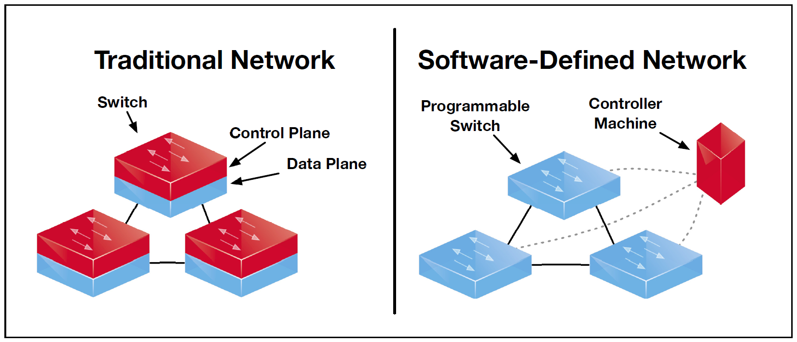
Traditional Network vs. SDN
Notes:
One key driving factor is the increasingly widespread use of server virtualization.
In essence, server virtualization masks server resources, including the number
and identity of individual physical servers, processors, and operating systems, from
server users. This makes it possible to partition a single machine into multiple independent
servers, conserving hardware resources. It also makes it possible to quickly
migrate a server from one machine to another for load balancing or for dynamic
switchover in the case of machine failure. Server virtualization has become a central
element in dealing with “big data” applications and in implementing cloud computing
infrastructures. But it creates problems with traditional network architectures
(e.g., see [LAYL10]). One problem is configuring virtual LANs. Network managers
need to make sure the VLAN used by the virtual machine (VM) is assigned to the
same switch port as the physical server running the VM. But with the VM being
movable, it is necessary to reconfigure the VLAN every time that a virtual server
is moved. In general terms, to match the flexibility of server virtualization, the
network manager needs to be able to dynamically add, drop, and change network
resources and profiles. This is difficult to do with conventional network switches, in
which the control logic for each switch is collocated with the switching logic.
Another effect of server virtualization is that traffic flows differ substantially
from the traditional client/server model. Typically, there is a considerable amount
of traffic among virtual servers, for such purposes as maintaining consistent images
of database and invoking security functions such as access control. These serverto-
server flows change in location and intensity over time, demanding a flexible
approach to managing network resources.
Another factor leading to the need for rapid response in allocating network
resources is the increasing use by employees of mobile devices, such as smartphones,
tablets, and notebooks to access enterprise resources. Network managers must be
able to respond to rapidly changing resource, QoS, and security requirements.
Existing network infrastructures can respond to changing requirements for
the management of traffic flows, providing differentiated QoS levels and security
levels for individual flows, but the process can be very time consuming if the enterprise
network is large and/or involves network devices from multiple vendors. The
network manager must configure each vendor’s equipment separately, and adjust
performance and security parameters on a per-session, per-application basis. In a
large enterprise, every time a new virtual machine is brought up, it can take hours
or even days for network managers to do the necessary reconfiguration [ONF12].
This state of affairs has been compared to the mainframe era of computing
[DELL12]. In the era of the mainframe, applications, the operating system, and the
hardware were vertically integrated and provided by a single vendor. All of these
ingredients were proprietary and closed, leading to slow innovation. Today, most
computer platforms use the x86 instruction set and a variety of operating systems
(Windows, Linux, Mac OS) run on top of the hardware. The OS provides APIs
that enable outside providers to develop applications, leading to rapid innovation
and deployment. In a similar fashion, commercial networking devices have proprietary
features and specialized control planes and hardware, all vertically integrated
on the switch. As will be seen, the SDN architecture and the OpenFlow standard
provide an open architecture in which control functionality is separated from the
network device, and placed in accessible control servers. This enables the underlying
infrastructure to be abstracted for applications and network services, which can
treat the network as a logical entity.

Slide 9
Notes:
Figure 21.6 illustrates the logical structure of an SDN. A central controller performs
all complex functionality, including routing, naming, policy declaration, and security
checks. This constitutes the SDN control plane , and consists of one or more
SDN servers.
The SDN controller defines the data flows that occur in the SDN data plane .
Each flow through the network must first get permission from the controller, which
verifies that the communication is permissible by the network policy. If the controller
allows a flow, it computes a route for the flow to take, and adds an entry for
that flow in each of the switches along the path. With all complex function subsumed
by the controller, switches simply manage flow tables whose entries can only
be populated by the controller. Communication between the controller and the
switches uses a standardized protocol and API. Most commonly this interface is the
OpenFlow specification, discussed in the next section.
The SDN architecture is remarkably flexible; it can operate with different
types of switches and at different protocol layers. SDN controllers and switches can
be implemented for Ethernet switches (layer 2), Internet routers (layer 3), transport
(layer 4) switching, or application-layer switching and routing. SDN relies on the
common functions found on networking devices, which essentially involves forwarding
packets based on some form of flow definition. In an SDN architecture, a
switch performs the following functions:
1. The switch encapsulates and forwards a flow’s first packet to an SDN controller,
enabling the controller to decide whether the flow should be added to the
switch’s flow table.
2. The switch forwards incoming packets out the appropriate port based on the
flow table. The flow table may include priority information dictated by the
controller.
3. The switch can drop packets on a particular flow, temporarily or permanently,
as dictated by the controller. Packet dropping can be used for security purposes,
curbing denial-of-service attacks, or traffic management requirements.
In simple terms, the SDN controller manages the forwarding state of the
switches in the SDN. This management is done through a vendor-neutral API that
allows the controller to address a wide variety of operator requirements without
changing any of the lower-level aspects of the network, including topology.
With the decoupling of the control and data planes, SDN enables applications
to deal with a single abstracted network device, without concern for the
details of how the device operates. Network applications see a single API to
the controller. Thus it is possible to quickly create and deploy new applications
to orchestrate network traffic flow to meet specific enterprise requirements for
performance or security.

Slide 10
Notes:
In a large enterprise network, the deployment of a single controller to manage all
network devices would prove unwieldy or undesirable. A more likely scenario is
that the operator of a large enterprise or carrier network divides the whole network
into a number of nonoverlapping SDN domains (Figure 21.7).

Slide 11
OpenFlow
Defined in the OpenFlow Switch Specification published by the Open Networking Foundation (ONF)
Is both a protocol between SDN controllers and network devices and a specification of the logical structure of the network switch functionality
To turn the concept of SDN into practical implementation two requirements must be met:
1
2
There must be a common logical architecture in all switches, routers, and other network devices to be managed by an SDN controller
A standard, secure protocol is needed between the SDN controller and the network device
Notes:
To turn the concept of SND into practical implementation, two requirements must be
met. First, there must be a common logical architecture in all switches, routers, and
other network devices to be managed by an SDN controller. This logical architecture
may be implemented in different ways on different vendor equipment and in different
types of network devices, so long as the SDN controller sees a uniform logical switch
functionality. Second, a standard, secure protocol is needed between the SDN controller
and the network device. Both of these requirements are addressed by OpenFlow,
which is both a protocol between SDN controllers and network devices and a specification
of the logical structure of the network switch functionality. OpenFlow is
defined in the OpenFlow Switch Specification , published by the Open Networking
Foundation (ONF). ONF is a consortium of software providers, content delivery networks,
and networking equipment vendors whose purpose is to promote softwaredefined
networking.
This section is based on the current OpenFlow specification, Version 1.3.0,
June 25, 2012. The original specification, 1.0, was developed at Stanford University
and was widely implemented. OpenFlow 1.2 was the first release from ONF after
inheriting the project from Stanford. OpenFlow 1.3 significantly expands the functionality
of the specification. Version 1.3 is likely to become the stable base upon
which future commercial implementations for OpenFlow will be built. ONF intends
for this version to be a stable target for chip and software vendors, so little if any
change is planned for the foreseeable future [KERN12].

Slide 12
Notes:
Figure 21.8 illustrates the basic structure of the OpenFlow environment. An
SDN controller communicates with OpenFlow-compatible switches using the
OpenFlow protocol running over the Secure Sockets Layer (SSL). Each switch
connects to other OpenFlow switches and, possibly, to end-user devices that are
the sources and destinations of packet flows. Within each switch, a series of tables,
typically implemented in hardware or firmware, are used to manage the flows of
packets through the switch.

Slide 13
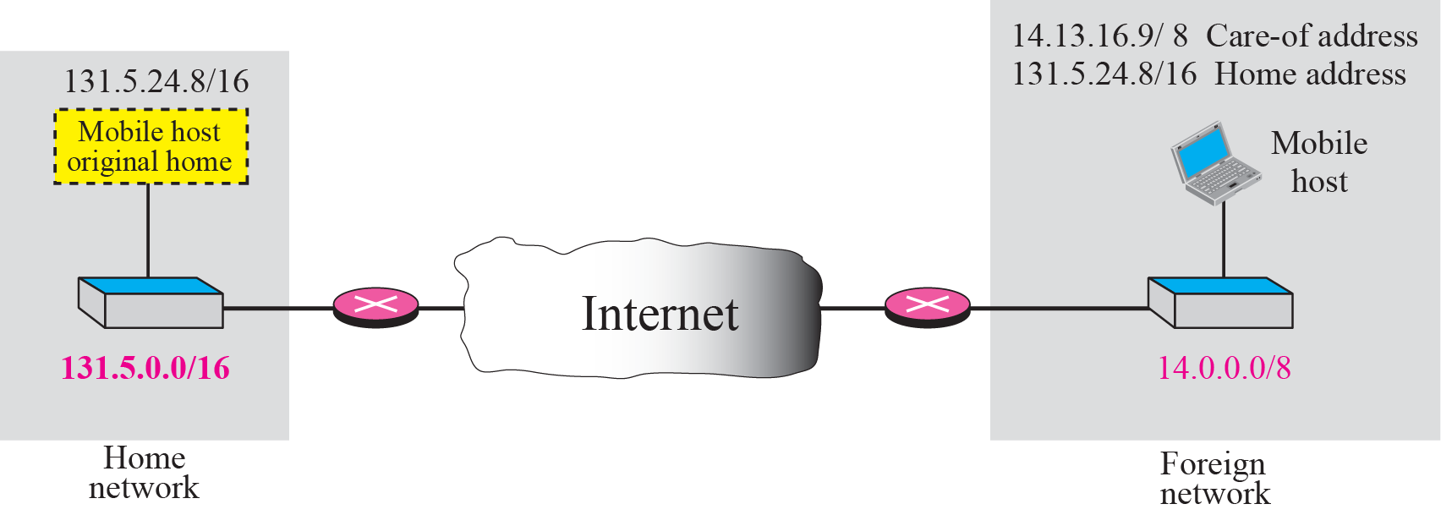
Mobile IP
Home & Care-of address
Notes:
As was described earlier in this chapter, routers make use of the IP address in an IP datagram to perform routing. In particular, the network portion of an IP address (Figure 14.6) is used by routers to move a datagram from the source computer to the network to which the target computer is attached. Then the final router on the path, which is attached to the same network as the target computer, uses the host portion of the IP address to deliver the IP datagram to the destination. Further, this IP address is known to the next higher layer in the protocol architecture (Figure 14.1). In particular, most applications over the Internet are supported by TCP connections. When a TCP connection is set up, the TCP entity on each side of the connection knows the IP address of the correspondent host. When a TCP segment is handed down to the IP layer for delivery, TCP provides the IP address, and IP creates an IP datagram with that IP address in the IP header and sends the datagram out for routing and delivery. However, with a mobile host, the IP address may change while one or more TCP connections are active.

Slide 14
Basic Capabilities of Mobile IP
Mobile IP includes three basic capabilities
Discovery
Care-of address
A discovery procedure is used to identify prospective home and foreign agents
Registration
Home → Care-of
Authenticated registration procedure is used
Tunneling
HA ==> FA
Forwards IP datagram from a home address to a care-of address
Notes:
To support the operations illustrated in Figure 21.10, Mobile IP includes three basic capabilities:
Discovery: A mobile node uses a discovery procedure to identify prospective home agents and foreign agents.
Registration: A mobile node uses an authenticated registration procedure to inform its home agent of its care-of address.
Tunneling: Tunneling is used to forward IP datagrams from a home address to a care-of address.

Slide 15
Mobile IP Scenario
Notes:
Figure 21.10 shows in general terms how Mobile IP deals with the problem of dynamic IP addresses. A mobile node is assigned to a particular network, known as its home network. Its IP address on that network, known as its home address, is static. When the mobile node moves its attachment point to another network, that network is considered a foreign network for this host. Once the mobile node is reattached, it makes its presence known by registering with a network node, typically a router, on the foreign network known as a foreign agent. The mobile node then communicates with a similar agent on the user's home network, known as a home agent, giving the home agent the care-of address of the mobile node; the care-of address identifies the foreign agent's location. Typically, one or more routers on a network will implement the roles of both home and foreign agents.

Slide 16
Internet QoS
Notes:
Before looking at the Internet standards that deal with provision of quality of service
(QoS) in the Internet and private internetworks, it is useful to consider an overall
architectural framework that relates the various elements that go into QoS provision.
Such a framework has been developed by the Telecommunication Standardization
Sector of the International Telecommunication Union (ITU-T) as part of its Y series
of Recommendations. The Recommendation, Y.1291 (An Architectural Framework
for Support of Quality of Service in Packet Networks ), gives a “big picture” overview
of the mechanisms and services that comprise a QoS facility.
The Y.1291 framework comprises a set of generic network mechanisms for
controlling the network service response to a service request, which can be specific
to a network element, or for signaling between network elements, or for controlling
and administering traffic across a network. Figure 22.1 shows the relationship
among these elements, which are organized into three planes: data, control, and
management.

Slide 17
Internet QoS
RSVP
Per Flow
Integrated Service Architecture
Datagram + QoS
Complicated
Per Class
Differentiated Service
Flow
Manageable
(Im/Ex-plicit)
IPv4
IPv6
DS Codepoint
Sevice Level Agreement
IP Performance Metric

