Slide 1
Data and Computer Communications
Tenth Edition
by William Stallings
Notes:
“Data and Computer Communications”, 10/e, by William Stallings, Chapter 20 “Congestion Control”.

Slide 2
Congestion Control
Chapter 20
Notes:
This chapter focuses on congestion control in switched data networks,
including packet-switching networks and the Internet. The chapter also discusses
TCP congestion control and a new protocol that provides congestion
control with an unreliable service. The next three chapters look at additional
congestion control mechanisms in our discussion of internetwork operation.

Slide 3
We were doing very well, up to the kind of sum when a bath is filling at the rate of so many gallons and two holes are letting the water out, and please to say how long it will take to fill the bath, when my mother put down the socks she was darning and clicked her tongue in impatience.
"Filling up an old bath with holes in it, indeed. Who would be such a fool?"
"A sum it is, girl," my father said. "A sum. A problem for the mind."
"Filling the boy with old nonsense," Mama said.
"Not nonsense, Beth," my father said. "A sum, it is. The water pours in and takes so long. It pours out and takes so long. How long to fill? That is all."
"But who would pour water into an old bath with holes?" my mother said. "Who would think to do it, but a lunatic?"
—How Green Was My Valley,
Richard Llewellyn
Notes:
Congestion is a critical problem for all types of switched data networks. The
phenomenon of congestion is a complex one, as is the subject of congestion
control. In very general terms, congestion occurs when the number of packets
being transmitted through a network begins to approach the packet-handling
capacity of the network. The objective of congestion control is to maintain the
number of packets within the network below the level at which performance
falls off dramatically.
To understand the issues involved in congestion control, we need to look
at some results from queuing theory. In essence, a data network or internet
is a network of queues. At each node (data network switch, internet router),
there is a queue of packets for each outgoing channel. If the rate at which packets
arrive and queue up exceeds the rate at which packets can be transmitted,
the queue size grows without bound and the delay experienced by a packet
goes to infinity. Even if the packet arrival rate is less than the packet transmission
rate, queue length will grow dramatically as the arrival rate approaches
the transmission rate. As a rule of thumb, when the line for which packets
are queuing becomes more than 80% utilized, the queue length grows at an
alarming rate. This growth in queue length means that the delay experienced
by a packet at each node increases. Further, since the size of any queue is
finite, as queue length grows, eventually the queue must overflow.

Slide 4
Notes:
Consider the queuing situation at a single packet switch or router, such as is illustrated in Figure 20.1. Any given node has a number of I/O ports attached to it: one or more to other nodes, and zero or more to end systems. On each port, packets arrive and depart. We can consider that there are two buffers, or queues, at each port, one to accept arriving packets, and one to hold packets that are waiting to depart. In practice, there might be two fixed-size buffers associated with each port, or there might be a pool of memory available for all buffering activities. In the latter case, we can think of each port having two variable-size buffers associated with it, subject to the constraint that the sum of all buffer sizes is a constant.
In any case, as packets arrive, they are stored in the input buffer of the corresponding port. The node examines each incoming packet, makes a routing decision, and then moves the packet to the appropriate output buffer. Packets queued for output are transmitted as rapidly as possible; this is, in effect, statistical time division multiplexing. If packets arrive too fast for the node to process them (make routing decisions) or faster than packets can be cleared from the outgoing buffers, then eventually packets will arrive for which no memory is available.

Slide 5
Flow
Control
Notes:
When such a saturation point is reached, one of two general strategies can be
adopted. The first such strategy is to discard any incoming packet for which there is
no available buffer space. The alternative is for the node that is experiencing these
problems to exercise some sort of flow control over its neighbors so that the traffic
flow remains manageable. But, as Figure 20.2 illustrates, each of a node’s neighbors
is also managing a number of queues. If node 6 restrains the flow of packets from
node 5, this causes the output buffer in node 5 for the port to node 6 to fill up. Thus,
congestion at one point in the network can quickly propagate throughout a region
or the entire network. While flow control is indeed a powerful tool, we need to use
it in such a way as to manage the traffic on the entire network.

Slide 6
Notes:
Figure 20.3 suggests the ideal goal for network utilization. The top graph plots the
steady-state total throughput (number of packets delivered to destination end systems)
through the network as a function of the offered load (number of packets
transmitted by source end systems), both normalized to the maximum theoretical
throughput of the network. For example, if a network consists of a single node with
two full-duplex 1-Mbps links, then the theoretical capacity of the network is 2 Mbps,
consisting of a 1-Mbps flow in each direction. In the ideal case, the throughput of
the network increases to accommodate load up to an offered load equal to the full
capacity of the network; then normalized throughput remains at 1.0 at higher input
loads. Note, however, what happens to the end-to-end delay experienced by the
average packet even with this assumption of ideal performance. At negligible load,
there is some small constant amount of delay that consists of the propagation delay
through the network from source to destination plus processing delay at each node.
As the load on the network increases, queueing delays at each node are added to
this fixed amount of delay. The reason for the increase in delay even when the total
network capacity is not exceeded has to do with the variability in load at each node.
With multiple sources supplying data to the network, even if each source produced
packets at fixed intervals, there will be fluctuation in the input rate at each individual
network node. When a burst of packets arrives at a node, it will take some
time to clear the backlog. As it is clearing the backlog, it is sending out a sustained
burst of packets, thus imposing packet bursts on downstream node. And once a
queue builds up at a node, even if packets only arrive at a rate the node can handle
during a given time period, those packets have to wait their turn in the queue, and
thus experience additional delay.
Once the load exceeds the network capacity, delays increase without bound.
Here is a simple intuitive explanation of why delay must go to infinity. Suppose that
each node in the network is equipped with buffers of infinite size and suppose that
the input load exceeds network capacity. Under ideal conditions, the network will
continue to sustain a normalized throughput of 1.0. Therefore, the rate of packets
leaving the network is 1.0. Because the rate of packets entering the network is
greater than 1.0, internal queue sizes grow. In the steady state, with input greater
than output, these queue sizes grow without bound and therefore queueing delays
grow without bound.
It is important to grasp the meaning of Figure 20.3 before looking at real-world
conditions. This figure represents the ideal, but unattainable, goal of all traffic and
congestion control schemes. No scheme can exceed the performance depicted in
Figure 20.3.

Slide 7
Notes:
The ideal case reflected in Figure 20.3 assumes infinite buffers and no overhead
related to congestion control. In practice, buffers are finite, leading to buffer overflow,
and attempts to control congestion consume network capacity in the exchange
of control signals.
Let us consider what happens in a network with finite buffers if no attempt is
made to control congestion or to restrain input from end systems. The details will,
of course, differ depending on network configuration and on the statistics of the
presented traffic. However, the graphs in Figure 20.4 depict the devastating outcome
in general terms.
At light loads, throughput, and hence network utilization, increases as the
offered load increases. As the load continues to increase, a point is reached (point A
in the plot) beyond which the throughput of the network increases at a rate slower
than the rate at which offered load is increased. This is due to network entry into a
moderate congestion state. In this region, the network continues to cope with the
load, although with increased delays. The departure of throughput from the ideal
is accounted for by a number of factors. For one thing, the load is unlikely to be
spread uniformly throughout the network. Therefore, while some nodes may experience
moderate congestion, others may be experiencing severe congestion and may
need to discard traffic. In addition, as the load increases, the network will attempt to
balance the load by routing packets through areas of lower congestion. For the routing
function to work, an increased number of routing messages must be exchanged
between nodes to alert each other to areas of congestion; this overhead reduces the
capacity available for data packets.
As the load on the network continues to increase, the queue lengths of the
various nodes continue to grow. Eventually, a point is reached (point B in the plot)
beyond which throughput actually drops with increased offered load. The reason
for this is that the buffers at each node are of finite size. When the buffers at a node
become full, the node must discard packets. Thus, the sources must retransmit the
discarded packets in addition to new packets. This only exacerbates the situation:
As more and more packets are retransmitted, the load on the system grows, and
more buffers become saturated. While the system is trying desperately to clear the
backlog, users are pumping old and new packets into the system. Even successfully
delivered packets may be retransmitted because it takes too long, at a higher layer
(e.g., transport layer), to acknowledge them: The sender assumes the packet did not
get through and retransmits. Under these circumstances, the effective capacity of
the system declines to zero.

Slide 8
Notes:
In this section, we introduce various techniques for controlling congestion in
packet-switching networks, the Internet, and private internets. To give context to
this discussion, Figure 20.5 provides a general depiction of important congestion
control techniques.

Slide 9
Backpressure
If node becomes congested it can slow down or stop flow of packets from other nodes
Can be exerted on the basis of links or logical connections
Flow restriction propagates backward to sources, which are restricted in the flow of new packets into the network
Can be selectively applied to logical connections so that the flow from one node to the next is only restricted or halted on some connections
Notes:
We have already made reference to backpressure as a technique for congestion
control. This technique produces an effect similar to backpressure in fluids flowing
down a pipe. When the end of a pipe is closed (or restricted), the fluid pressure
backs up the pipe to the point of origin, where the flow is stopped (or slowed).
Backpressure can be exerted on the basis of links or logical connections (e.g.,
virtual circuits). Referring again to Figure 20.2, if node 6 becomes congested (buffers
fill up), then node 6 can slow down or halt the flow of all packets from node
5 (or node 3, or both nodes 5 and 3). If this restriction persists, node 5 will need
to slow down or halt traffic on its incoming links. This flow restriction propagates
backward (against the flow of data traffic) to sources, which are restricted in the
flow of new packets into the network.
Backpressure can be selectively applied to logical connections, so that the flow
from one node to the next is only restricted or halted on some connections, generally
the ones with the most traffic. In this case, the restriction propagates back along
the connection to the source.

Slide 10
Choke Packet
A control packet
  Generated at congested node
  Sent back to source node
  An example is the Internet Control Message Protocol (ICMP) Source Quench packet
    From router or destination end system
    Source cuts back until it no longer receives quench messages
    Message is issued for every discarded packet
    Message may also be issued for anticipated congestion
Is a crude technique for controlling congestion
Notes:
A choke packet is a control packet generated at a congested node and transmitted back to a source node to restrict traffic flow. An example of a choke packet is the ICMP (Internet Control Message Protocol) Source Quench packet. Either a router or a destination end system may send this message to a source end system, requesting that it reduce the rate at which it is sending traffic to the internet destination. On receipt of a source quench message, the source host should cut back the rate at which it is sending traffic to the specified destination until it no longer receives source quench messages. The source quench message can be used by a router or host that must discard IP datagrams because of a full buffer. In that case, the router or host will issue a source quench message for every datagram that it discards. In addition, a system may anticipate congestion and issue source quench messages when its buffers approach capacity. In that case, the datagram referred to in the source quench message may well be delivered. Thus, receipt of a source quench message does not imply delivery or nondelivery of the corresponding datagram.
The choke package is a relatively crude technique for controlling congestion. More sophisticated forms of explicit congestion signaling are discussed subsequently.

Slide 11
Implicit Congestion Signaling
With network congestion:
  Transmission delay increases
  Packets may be discarded
Source can detect congestion and reduce flow
Responsibility of end systems
Effective on connectionless (datagram) networks
Also used in connection-oriented networks
  LAPF control is capable of detecting lost frames
Notes:
When network congestion occurs, two things may happen: (1) The transmission delay for an individual packet from source to destination increases, so that it is noticeably longer than the fixed propagation delay, and (2) packets are discarded. If a source is able to detect increased delays and packet discards, then it has implicit evidence of network congestion. If all sources can detect congestion and, in response, reduce flow on the basis of congestion, then the network congestion will be relieved. Thus, congestion control on the basis of implicit signaling is the responsibility of end systems and does not require action on the part of network nodes.
Implicit signaling is an effective congestion control technique in connectionless, or datagram, configurations, such as datagram packet-switching networks and IP-based internets. In such cases, there are no logical connections through the internet on which flow can be regulated. However, between the two end systems, logical connections can be established at the TCP level. TCP includes mechanisms for acknowledging receipt of TCP segments and for regulating the flow of data between source and destination on a TCP connection.
Implicit signaling can also be used in connection-oriented networks. For example, in frame relay networks, the LAPF control protocol, which is end to end, includes facilities similar to those of TCP for flow and error control. LAPF control is capable of detecting lost frames and adjusting the flow of data accordingly.

Slide 12
Explicit Congestion Signaling
Backward
  Congestion avoidance notification in opposite direction to packet required
Forward
  Congestion avoidance notification in same direction as packet required
Network alerts end systems of increasing congestion
End systems take steps to reduce offered load
Notes:
It is desirable to use as much of the available capacity in a network as possible but still react to congestion in a controlled and fair manner. This is the purpose of explicit congestion avoidance techniques. In general terms, for explicit congestion avoidance, the network alerts end systems to growing congestion within the network and the end systems take steps to reduce the offered load to the network.
Typically, explicit congestion control techniques operate over connection-oriented networks and control the flow of packets over individual connections. Explicit congestion signaling approaches can work in one of two directions:
Backward: Notifies the source that congestion avoidance procedures should be initiated where applicable for traffic in the opposite direction of the received notification. It indicates that the packets that the user transmits on this logical connection may encounter congested resources. Backward information is transmitted either by altering bits in a header of a data packet headed for the source to be controlled or by transmitting separate control packets to the source.
Forward: Notifies the user that congestion avoidance procedures should be initiated where applicable for traffic in the same direction as the received notification. It indicates that this packet, on this logical connection, has encountered congested resources. Again, this information may be transmitted either as altered bits in data packets or in separate control packets. In some schemes, when a forward signal is received by an end system, it echoes the signal back along the logical connection to the source. In other schemes, the end system is expected to exercise flow control upon the source end system at a higher layer (e.g., TCP).

Slide 13
Explicit Signaling Categories
Binary
•A bit set in a packet indicates congestion
Credit based
•Indicates how many packets source may send
Rate based
•Supply explicit data rate limit
•Common for end-to-end flow control
•Nodes along path may request rate reduction
Notes:
We can divide explicit congestion signaling approaches into three general categories:
Binary: A bit is set in a data packet as it is forwarded by the congested node. When a source receives a binary indication of congestion on a logical connection, it may reduce its traffic flow.
Credit based: These schemes are based on providing an explicit credit to a source over a logical connection. The credit indicates how many octets or how many packets the source may transmit. When the credit is exhausted, the source must await additional credit before sending additional data. Credit-based schemes are common for end-to-end flow control, in which a destination system uses credit to prevent the source from overflowing the destination buffers, but credit-based schemes have also been considered for congestion control.
Rate based: These schemes are based on providing an explicit data rate limit to the source over a logical connection. The source may transmit data at a rate up to the set limit. To control congestion, any node along the path of the connection can reduce the data rate limit in a control message to the source.

Slide 14
Traffic Management
Fairness
Provide equal treatment of various flows
Quality of service
Different treatment for different connections
Reservations
Traffic contract between user and network
Excess traffic discarded or handled on a best-effort basis
Notes:
There are a number of issues related to congestion control that might be included under the general category of traffic management. In its simplest form, congestion control is concerned with efficient use of a network at high load. The various mechanisms discussed in the previous section can be applied as the situation arises, without regard to the particular source or destination affected. When a node is saturated and must discard packets, it can apply some simple rule, such as discard the most recent arrival. However, other considerations can be used to refine the application of congestion control techniques and discard policy. We briefly introduce several of those areas here.
Fairness
As congestion develops, flows of packets between sources and destinations will experience increased delays and, with high congestion, packet losses. In the absence of other requirements, we would like to assure that the various flows suffer from congestion equally. Simply to discard on a last-in-first-discarded basis may not be fair. As an example of a technique that might promote fairness, a node can maintain a separate queue for each logical connection or for each source-destination pair. If all of the queue buffers are of equal length, then the queues with the highest traffic load will suffer discards more often, allowing lower-traffic connections a fair share of the capacity.
Quality of Service
We might wish to treat different traffic flows differently. For example, as [JAIN92] points out, some applications, such as voice and video, are delay sensitive but loss insensitive. Others, such as file transfer and electronic mail, are delay insensitive but loss sensitive. Still others, such as interactive graphics or interactive computing applications, are delay sensitive and loss sensitive. Also, different traffic flows have different priorities; for example, network management traffic, particularly during times of congestion or failure, is more important than application traffic.
It is particularly important during periods of congestion that traffic flows with different requirements be treated differently and provided a different quality of service (QoS). For example, a node might transmit higher-priority packets ahead of lower-priority packets in the same queue. Or a node might maintain different queues for different QoS levels and give preferential treatment to the higher levels.
Reservations
One way to avoid congestion and also to provide assured service to applications is to use a reservation scheme. Such a scheme is an integral part of ATM networks. When a logical connection is established, the network and the user enter into a traffic contract, which specifies a data rate and other characteristics of the traffic flow. The network agrees to give a defined QoS so long as the traffic flow is within contract parameters; excess traffic is either discarded or handled on a best-effort basis, subject to discard. If the current outstanding reservations are such that the network resources are inadequate to meet the new reservation, then the new reservation is denied.
One aspect of a reservation scheme is traffic policing. A node in the network, typically the node to which the end system attaches, monitors the traffic flow and compares it to the traffic contract. Excess traffic is either discarded or marked to indicate that it is liable to discard or delay.

Slide 15

Traffic Shaping/Traffic Policing
Two important tools in network management:
  Traffic shaping
    Concerned with traffic leaving the switch
    Reduces packet clumping
    Produces an output packet stream that is less burst and with a more regular flow of packets
  Traffic policing
    Concerned with traffic entering the switch
    Packets that don’t conform may be treated in one of the following ways:
      Give the packet lower priority compared to packets in other output queues
      Label the packet as nonconforming by setting the appropriate bits in a header
      Discard the packet
Notes:
Two important tools in managing network are traffic shaping and traffic policing.
Traffic shaping is aimed at smoothing out traffic flow by reducing packet clumping
that leads to fluctuations in buffer occupancy. In essence, if the input to a
switch on a certain channel or logical connection or flow is bursty, traffic shaping
produces an output packet stream that is less bursty and with a more regular flow
of packets.
Traffic policing discriminates between incoming packets that conform to quality
of service (QoS) agreement and those that don’t. Packets that don’t conform
may be treated in one of the following ways:
1. Give the packet lower priority compared to packets in other output queues.
2. Label the packet as nonconforming by setting the appropriate bits in a header.
Downstream switches may treat nonconforming packets less favorably if
congestion
occurs.
3. Discard the packet.
In essence, traffic shaping is concerned with traffic leaving the switch and traffic
policing is concerned with traffic entering the switch. Two important techniques
that can be used for traffic shaping or traffic policing are token bucket and leaky
bucket.

Slide 16
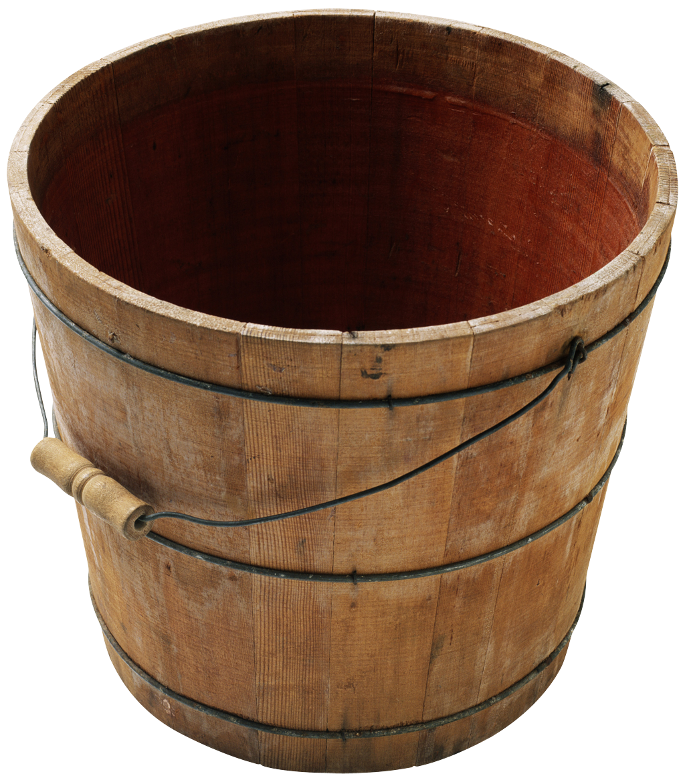
Token Bucket
Widely used traffic management tool
Advantages:
  Many traffic sources can be defined easily and accurately
  Provides a concise description of the load to be imposed by a flow, enabling the service to determine easily the resource requirement
  Provides the input parameters to a policing function
Notes:
A widely used traffic management tool is token bucket. This is a
way of characterizing and managing traffic that has three advantages:
1. Many traffic sources can be defined easily and accurately by a token bucket
scheme.
2. The token bucket scheme provides a concise description of the load to be
imposed by a flow, enabling the service to determine easily the resource
requirement.
3. The token bucket scheme provides the input parameters to a policing function.
This scheme provides a concise description of the peak and average traffic load
the recipient can expect and it also provides a convenient mechanism by which the
sender can implement a traffic flow policy. Token bucket is used in the Bluetooth
(Chapter 18) specification and in differentiated services (Chapter 22).

Slide 17
During any time period T, the amount of data sent cannot exceed RT+B
Notes:
A token bucket traffic specification consists of two parameters: a token
replenishment rate R and a bucket size B. The token rate R specifies the continually
sustainable data rate; that is, over a relatively long period of time, the
average data rate to be supported for this flow is R. The bucket size B specifies
the amount by which the data rate can exceed R for short periods of time. The
exact condition is as follows: during any time period T, the amount of data sent
cannot exceed RT + B.
Figure 20.6 illustrates this scheme and explains the use of the term bucket.
The bucket represents a counter that indicates the allowable number of bytes of
data that can be sent at any time. The bucket fills with byte tokens at the rate of R
(i.e., the counter is incremented R times per second), up to the bucket capacity (up
to the maximum counter value). Data arrive from the user and are assembled into
packets, which are queued for transmission. A packet may be transmitted if there
are sufficient tokens to match the packet size. If so, the packet is transmitted and
the bucket is drained of the corresponding number of tokens. If there are insufficient
tokens available, then the packet exceeds the specification for this flow. The
treatment for such packets is a design or implementation decision. Possible actions
including:
• Queue the packet for transmission until sufficient tokens are available and
then transmit.
• Queue the packet for transmission until sufficient tokens are available but
label the packet as exceeding a threshold.
• Discard the packet.
The last option is generally not used with token bucket. Token bucket is typically
used for traffic shaping but not traffic policing.
The result of this scheme is that if there is a backlog of packets and an empty
bucket, then packets are emitted at a smooth flow of packets per second with
no packet delay variation until the backlog is cleared. Thus, the token bucket
smooths out bursts of cells. Over the long run, the rate of data allowed by the
token bucket is R . However, if there is an idle or relatively slow period, the bucket
capacity builds up, so that at most an additional B bytes above the stated rate can
be accepted. Thus, B is a measure of the degree of burstiness of the data flow that
is allowed.

Slide 18
Notes:
Another scheme, similar to token bucket, is leaky bucket. Leaky
bucket is used in the asynchronous transfer mode (ATM) specification and in the
ITU-T H.261 standard for digital video coding and transmission. The basic principle
of leaky bucket is depicted in Figure 20.7. The algorithm maintains a running
count of the cumulative amount of data sent in a counter X . The counter is decremented
at a constant rate of one unit per time unit to a minimum value of zero; this
is equivalent to a bucket that leaks at a rate of 1. The counter is incremented by I for
each arriving packet, where I is the size of the packet, subject to the restriction that
the maximum counter value is L . Any arriving cell that would cause the counter to
exceed its maximum is defined as nonconforming; this is equivalent to a bucket with
a capacity of L .
The token bucket and leaky bucket schemes operate in a similar fashion, but
there are some differences. A token bucket fills at a constant rate up to the capacity
of the bucket and empties at a rate dictated by the input data stream while the
bucket is not empty. A leaky bucket empties at a constant rate while the bucket is
not empty and fills at a rate dictated by the input stream up to the capacity of the
bucket. Thus, for token bucket, as the rate of incoming packets rise, the output of
the system speeds up. In effect, token bucket gives credit to a flow or connection
that is underused, up to a point.

Slide 19
Congestion Control in
Packet-Switching Networks
Send control packet to some or all source nodes
Requires additional traffic during congestion
Rely on routing information
May react too quickly
End to end probe packets
Adds to overhead
Add congestion information to packets in transit
Either backwards or forwards
Notes:
A number of control mechanisms for congestion control in packet-switching networks
have been suggested and tried. The following are examples:
1. Send a control packet from a congested node to some or all source nodes. This
choke packet will have the effect of stopping or slowing the rate of transmission
from sources and hence limit the total number of packets in the network.
This approach requires additional traffic on the network during a period of
congestion.
2. Rely on routing information. Routing algorithms, such as ARPANET’s, provide
link delay information to other nodes, which influences routing decisions.
This information could also be used to influence the rate at which new packets
are produced. Because these delays are being influenced by the routing decision,
they may vary too rapidly to be used effectively for congestion control.
3. Make use of an end-to-end probe packet. Such a packet could be timestamped
to measure the delay between two particular endpoints. This has the disadvantage
of adding overhead to the network.
4. Allow packet-switching nodes to add congestion information to packets as
they go by. There are two possible approaches here. A node could add such
information to packets going in the direction opposite of the congestion. This
information quickly reaches the source node, which can reduce the flow of
packets into the network. Alternatively, a node could add such information to
packets going in the same direction as the congestion. The destination either
asks the source to adjust the load or returns the signal back to the source in the
packets (or acknowledgments) going in the reverse direction.

Slide 20
TCP Congestion Control
Flow control also used for congestion control
  Recognize increased transit times & dropped packets
  React by reducing flow of data
RFC’s 1122 & 2581 detail extensions
  Tahoe, Reno & New Reno implementations
Two categories of extensions:
  Retransmission timer management
  Window management
Notes:
The credit-based flow control mechanism of TCP was designed to enable a destination to restrict the flow of segments from a source to avoid buffer overflow at the destination. This same flow control mechanism is now used in ingenious ways to provide congestion control over the Internet between the source and destination. As congestion begins to occur, the transit time across a network or internetwork increases, and network or internet nodes drop packets. The TCP flow control mechanism can be used to recognize the onset of congestion (by recognizing increased delay times and dropped segments) and to react by reducing the flow of data. If many of the TCP entities operating across a network exercise this sort of restraint, internet congestion is relieved.
Since the publication of RFC 793, a number of techniques have been implemented that are intended to improve TCP congestion control characteristics. None of these extend or violate the original TCP standard; rather they represent implementation policies that are within the scope of the TCP specification. Many of these techniques are mandated for use with TCP in RFC 1122 (Requirements for Internet Hosts) while some of them are specified in RFC 2581. The techniques fall roughly into two categories: retransmission timer management and window management. In this section, we look at some of the most important and most widely implemented of these techniques.
Since the publication of RFC 793, a number of techniques have been implemented that are intended to improve TCP congestion control characteristics.

Slide 21
Flow Ctrl vs. Congestion Ctrl
Why Flow Control?
Why Congestion Control?
Prevent Receiver
Buffer Overflow
Try Not To Cause
Congestion
Receiver-based
window size
(rwnd)
Network-based
window size
(cwnd)
Sender’s window = Min (cwnd, rwnd)

Slide 22
Table 20.1
Implementation of TCP Congestion Control Measures
Error Control ?!
Notes:
The credit-based flow control mechanism of TCP was designed to enable a destination
to restrict the flow of segments from a source to avoid buffer overflow at the
destination. This same flow control mechanism is now used in ingenious ways to
provide congestion control over the Internet between the source and destination.
Congestion, as we have seen a number of times in this book, has two main effects.
First, as congestion begins to occur, the transit time across a network or internetwork
increases. Second, as congestion becomes severe, network or internet nodes
drop packets. The TCP flow control mechanism can be used to recognize the onset
of congestion (by recognizing increased delay times and dropped segments) and to
react by reducing the flow of data. If many of the TCP entities operating across a
network exercise this sort of restraint, internet congestion is relieved.
Since the publication of RFC 793, a number of techniques have been implemented
that are intended to improve TCP congestion control characteristics.
Table 20.1 lists some of the most popular of these techniques. None of these
techniques extends or violates the original TCP standard; rather the techniques
represent implementation policies that are within the scope of the TCP specification.
Many of these techniques are mandated for use with TCP in RFC 1122
(Requirements for Internet Hosts ) while some of them are specified in RFC 5681.
The labels Tahoe, Reno, and NewReno refer to implementation packages available
on many operating systems that support TCP. The techniques fall roughly into two
categories: retransmission timer management and window management. In this section,
we look at some of the most important and most widely implemented of these
techniques.

Slide 23
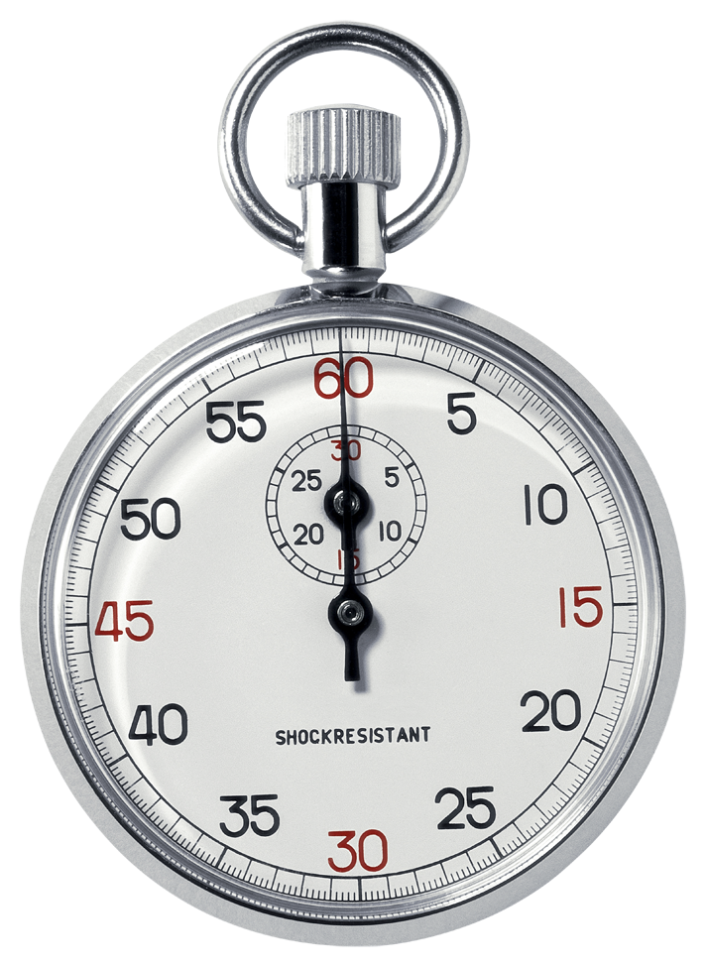
Retransmission Timer Management
As network or internet conditions change a static retransmission timer is likely to be either too long or too short
Virtually all TCP implementations attempt to estimate the current round-trip time and then set the timer to a value somewhat greater than the estimated time
Simple average:
Take the average of observed round-trip times over a number of segments
If the average accurately predicts future round-trip times, then the resulting retransmission timer will yield good performance
Exponential average:
Technique for predicting the next value on the basis of a time series of past values
Specified in RFC 793
Notes:
As network or internet conditions change, a static retransmission timer is likely
to be either too long or too short. Accordingly, virtually all TCP implementations
attempt to estimate the current round-trip time by observing the pattern of delay
for recent segments, and then set the timer to a value somewhat greater than the
estimated round-trip time.
A simple approach is to take the average of observed round-trip
times over a number of segments. If the average accurately predicts future roundtrip
times, then the resulting retransmission timer will yield good performance.
A common technique for predicting the next value
on the basis of a time series of past values, and the one specified in RFC 793, is
exponential averaging.

Slide 24
Retransmission Timer (cont)
Simple Average
  RTT(i): round-trip time observed for the i^{th} transmitted segment
  ARTT(K): average round-trip time for the first K segments
or

Slide 25
Retransmission Timer (cont)
Exponential Average
  SRTT: smoothed round-trip time estimate
  RTO: retransmission timer
RFC793:
Example values: α: 0.8 ~ 0.9, β: 1.3 ~ 2.0

Slide 26
RTT Variance Estimation
AERR(K): sample mean deviation measured at time K

Slide 27
RTT Variance Estimation (cont)
Jacobson’s Algorithm
g = 1/8 = 0.125, h = ¼ = 0.25, f = 2

Slide 28
Notes:
Figure 20.8 compares simple averaging with exponential averaging (for two
different values of a ). In part (a) of the figure, the observed value begins at 1,
grows gradually to a value of 10, and then stays there. In part (b) of the figure, the
observed value begins at 20, declines gradually to 10, and then stays there. Note
that exponential averaging tracks changes in RTT faster than does simple averaging
and that the smaller value of a results in a more rapid reaction to the change in the
observed value.

Slide 29
Notes:
Figure 20.9 illustrates the use of Equation (20.5) on the same data set used in
Figure 20.8. Once the arrival times stabilize, the variation estimate SDEV declines.
The values of RTO for both f = 2 and f = 4 are quite conservative as long as RTT
is changing but then begin to converge to RTT when it stabilizes.

Slide 30
Exponential RTO Backoff
When a TCP sender times out on a segment, it must retransmit that segment
  RFC 793 assumes that the same RTO value will be used
  Because the time-out is probably due to network congestion, maintaining the same RTO value is ill advised
A more sensible policy dictates that a sending TCP entity increase its RTO each time a segment is retransmitted
Notes:
When a TCP sender times out on a segment, it must
retransmit that segment. RFC 793 assumes that the same RTO value will be used
for this retransmitted segment. However, because the time-out is probably due to
network congestion, manifested as a dropped packet or a long delay in round-trip
time, maintaining the same RTO value is ill advised.
Consider the following scenario. There are a number of active TCP connections
from various sources sending traffic into an internet. A region of congestion
develops such that segments on many of these connections are lost or delayed past
the RTO time of the connections. Therefore, at roughly the same time, many segments
will be retransmitted into the internet, maintaining or even increasing the
congestion. All of the sources then wait a local (to each connection) RTO time and
retransmit yet again. This pattern of behavior could cause a sustained condition of
congestion.
A more sensible policy dictates that a sending TCP entity increase its RTO
each time a segment is retransmitted; this is referred to as a backoff process. In the
scenario of the preceding paragraph, after the first retransmission of a segment on
each affected connection, the sending TCP entities will all wait a longer time before
performing a second retransmission. This may give the internet time to clear the
current congestion. If a second retransmission is required, each sending TCP entity
will wait an even longer time before timing out for a third retransmission, giving the
internet an even longer period to recover.

Slide 31
Karn’s Algorithm
Do not use the measured RTT for a retransmitted segment to update SRTT and SDEV
Calculate the backoff RTO using the equation RTO = q * RTO when a retransmission occurs
Use the backoff RTO value for succeeding segments until an acknowledgment arrives for a segment that has not been retransmitted
Notes:
If no segments are retransmitted, the sampling process for
Jacobson’s algorithm is straightforward. The RTT for each segment can be included
in the calculation. Suppose, however, that a segment times out and must be retransmitted.
If an acknowledgment is subsequently received, there are two possibilities:
1. This is the ACK to the first transmission of the segment. In this case, the
RTT is simply longer than expected but is an accurate reflection of network
conditions.
2. This is the ACK to the second transmission.
The sending TCP entity cannot distinguish between these two cases. If the
second case is true and the TCP entity simply measures the RTT from the first
transmission until receipt of the ACK, the measured time will be much too long.
The measured RTT will be on the order of the actual RTT plus the RTO. Feeding
this false RTT into Jacobson’s algorithm will produce an unnecessarily high value
of SRTT and therefore RTO. Furthermore, this effect propagates forward a number
of iterations, since the SRTT value of one iteration is an input value in the
next iteration.
An even worse approach would be to measure the RTT from the second
transmission to the receipt of the ACK. If this is in fact the ACK to the first transmission,
then the measured RTT will be much too small, producing a too low
value of SRTT and RTO. This is likely to have a positive feedback effect, causing
additional retransmissions and additional false measurements.
Karn’s algorithm [KARN91] solves this problem with the following rules:
1. Do not use the measured RTT for a retransmitted segment to update SRTT
and SDEV [Equation (20.5)].
2. Calculate the backoff RTO using Equation (20.6) when a retransmission
occurs.
3. Use the backoff RTO value for succeeding segments until an acknowledgment
arrives for a segment that has not been retransmitted.
When an acknowledgment is received to an unretransmitted segment,
Jacobson’s algorithm is again activated to compute future RTO values.

Slide 32
Window Management
The size of TCP’s send window can have a critical effect on whether TCP can be used efficiently without causing congestion
Two techniques found in virtually all modern implementation of TCP are:
  Slow start
  Dynamic window sizing on congestion
Notes:
In addition to techniques for improving the effectiveness of the retransmission
timer, a number of approaches to managing the send window have been examined.
The size of TCP’s send window can have a critical effect on whether TCP can be
used efficiently without causing congestion. We discuss two techniques found in virtually
all modern implementations of TCP: slow start and dynamic window sizing
on congestion.
The larger the send window used in TCP, the more segments that
a sending TCP entity can send before it must wait for an acknowledgment. This
can create a problem when a TCP connection is first established, because the TCP
entity is free to dump the entire window of data onto the internet.

Slide 33
Slow Start
Gradually expand the window until acknowledgments are received
TCP transmission is constrained by
awnd = MIN[credit, cwnd]
where
awnd = allowed window, in segment
  This is the number of segments that TCP is currently allowed to send without receiving further acknowledgments
cwnd= congestion window, in segments
  A window used by TCP during startup and to reduce flow during periods of congestion
credit = the amount of unused credit granted in the most recent acknowledgment, in segments
  When an acknowledgment is received, this value is calculated as window/segment_size, where window is a field in the incoming TCP segment (the amount of data the peer TCP entity is willing to accept)
Notes:
One strategy that could be followed is for the TCP sender to begin sending
from some relatively large but not maximum window, hoping to approximate the
window size that would ultimately be provided by the connection. This is risky
because the sender might flood the internet with many segments before it realized
from time-outs that the flow was excessive. Instead, some means is needed of gradually
expanding the window until acknowledgments are received. This is the purpose
of the slow-start mechanism.
awnd = allowed window, in segments. This is the number of segments
that TCP is currently allowed to send without receiving further
acknowledgments.
cwnd = congestion window, in segments. A window used by TCP during startup
and to reduce flow during periods of congestion.
credit = the amount of unused credit granted in the most recent acknowledgment,
in segments. When an acknowledgment is received, this value
is calculated as window/segment_size, where window is a field in the
incoming TCP segment (the amount of data the peer TCP entity is
willing to accept)
When a new connection is opened, the TCP entity initializes cwnd = 1. That
is, TCP is only allowed to send 1 segment and then must wait for an acknowledgment
before transmitting a second segment. Each time an acknowledgment to new
data is received, the value of cwnd is increased by 1, up to some maximum value.
In effect, the slow-start mechanism probes the internet to make sure that the
TCP entity is not sending too many segments into an already congested environment.
As acknowledgments arrive, TCP is able to open up its window until the flow
is controlled by the incoming ACKs rather than by cwnd .
The term slow start is a bit of a misnomer, because cwnd actually grows exponentially.
When the first ACK arrives, TCP opens cwnd to 2 and can send two
segments. When these two segments are acknowledged, TCP can slide the window
1 segment for each incoming ACK and can increase cwnd by 1 for each incoming
ACK. Therefore, at this point TCP can send four segments. When these four are
acknowledged, TCP will be able to send eight segments.

Slide 34
Notes:
The slow-start algorithm has been found to work effectively for initializing a connection. It enables the TCP sender
to determine quickly a reasonable window size for the connection. Might not the
same technique be useful when there is a surge in congestion? In particular, suppose
a TCP entity initiates a connection and goes through the slow-start procedure. At
some point, either before or after cwnd reaches the size of the credit allocated by
the other side, a segment is lost (time-out). This is a signal that congestion is occurring.
It is not clear how serious the congestion is. Therefore, a prudent procedure
would be to reset cwnd = 1 and begin the slow-start process all over.
This seems like a reasonable, conservative procedure, but in fact it is not conservative
enough. Jacobson [JACO88] points out that “it is easy to drive a network
into saturation but hard for the net to recover.” In other words, once congestion
occurs, it may take a long time for the congestion to clear. Thus, the exponential
growth of cwnd under slow start may be too aggressive and may worsen the congestion.
Instead, Jacobson proposed the use of slow start to begin with, followed by a
linear growth in cwnd . The rules are as follows. When a time-out occurs,
1. Set a slow-start threshold equal to half the current congestion window; that is,
set ssthresh = cwnd /2.
2. Set cwnd = 1 and perform the slow-start process until cwnd = ssthresh . In
this phase, cwnd is increased by 1 for every ACK received.
3. For cwnd ≥ ssthresh , increase cwnd by 1 for each round-trip time.
Figure 20.10 illustrates this behavior. Note that it takes 11 round-trip times to
recover to the cwnd level that initially took 4 round-trip times to achieve.

Slide 35
Fast Retransmit
Fast Recover
Under some circumstances improve on the performance provided by RTO
Takes advantage of the rule that if a TCP entity receives a segment out of order, it must immediately issue an ACK for the last in-order segment that was received
Retransmit the lost segment, cut cwnd in half, and then proceed with the linear increase of cwnd
RFC 3782 modifies the fast recovery algorithm to improve the response when two segments are lost within a single window
Notes:
The retransmission timer (RTO) that is used by a sending TCP
entity to determine when to retransmit a segment will generally be noticeably
longer than the actual round-trip time (RTT) that the ACK for that segment will
take to reach the sender. Both the original RFC 793 algorithm and the Jacobson
algorithm set the value of RTO at somewhat greater than the estimated round-trip
time SRTT. Several factors make this margin desirable:
1. RTO is calculated on the basis of a prediction of the next RTT, estimated
from past values of RTT. If delays in the network fluctuate, then the estimated
RTT may be smaller than the actual RTT.
2. Similarly, if delays at the destination fluctuate, the estimated RTT becomes
unreliable.
3. The destination system may not ACK each segment but cumulatively ACK
multiple segments, while at the same time sending ACKs when it has any data
to send. This behavior contributes to fluctuations in RTT.
A consequence of these factors is that if a segment is lost, TCP may be slow to
retransmit. If the destination TCP is using an in-order accept policy (see Section 15.2),
then many segments may be lost. Even in the more likely case that the destination
TCP is using an in-window accept policy, a slow retransmission can cause problems.
To see this, suppose that A transmits a sequence of segments, the first of which is lost.
So long as its send window is not empty and RTO does not expire, A can continue
to transmit without receiving an acknowledgment. B receives all of these segments
except the first. But B must buffer all of these incoming segments until the missing
one is retransmitted; it cannot clear its buffer by sending the data to an application
until the missing segment arrives. If retransmission of the missing segment is delayed
too long, B will have to begin discarding incoming segments.
Jacobson [JACO90b] proposed two procedures, called fast retransmit and fast
recovery, that under some circumstances improve on the performance provided by
RTO. Fast retransmit takes advantage of the following rule in TCP. If a TCP entity
receives a segment out of order, it must immediately issue an ACK for the last
in-order segment that was received. TCP will continue to repeat this ACK with each
incoming segment until the missing segment arrives to “plug the hole” in its buffer.
When the hole is plugged, TCP sends a cumulative ACK for all of the in-
order segments received so far.
When a source TCP receives a duplicate ACK, it means that either (1) the segment
following the ACKed segment was delayed so that it ultimately arrived out of
order or (2) that segment was lost. In case (1), the segment does ultimately arrive and
therefore TCP should not retransmit. But in case (2), the arrival of a duplicate ACK
can function as an early warning system to tell the source TCP that a segment has
been lost and must be retransmitted. To make sure that we have case (2) rather than
case (1), Jacobson recommends that a TCP sender wait until it receives three duplicate
ACKs to the same segment (i.e., a total of four ACKs to the same segment).
Under these circumstances, it is highly likely that the following segment has been
lost and should be retransmitted immediately, rather than waiting for a time-out.
When a TCP entity retransmits a segment using fast retransmit,
it knows (or rather assumes) that a segment was lost, even though it has
not yet timed out on that segment. Accordingly, the TCP entity should take congestion
avoidance measures. One obvious strategy is the slow-start/congestion
avoidance procedure used when a time-out occurs. That is, the entity could set
ssthresh to cwnd /2, setcwnd = 1 and begin the exponential slow-start process until
cwnd = ssthresh , and then increase cwnd linearly. Jacobson [JACO90b] argues that
this approach is unnecessarily conservative. As was just pointed out, the very fact
that multiple ACKs have returned indicates that data segments are getting through
fairly regularly to the other side. So Jacobson proposes a fast recovery technique:
Retransmit the lost segment, cut cwnd in half, and then proceed with the linear
increase of cwnd . This technique avoids the initial exponential slow-start process.
RFC 3782 (The NewReno Modification to TCP’s Fast Recovery Mechanism)
modifies the fast recovery algorithm to improve the response when two segments
are lost within a single window. Using fast retransmit, a sender retransmits a segment
before time-out because it infers that the segment was lost. If the sender
subsequently receives an acknowledgment that does not cover all of the segments
transmitted before fast retransmit was initiated, the sender may infer that two segments
were lost from the current window and retransmit an additional segment.
The details of both fast recovery and modified fast recovery are complex; the reader
is referred to RFCs 5681 and 3782.

Slide 36
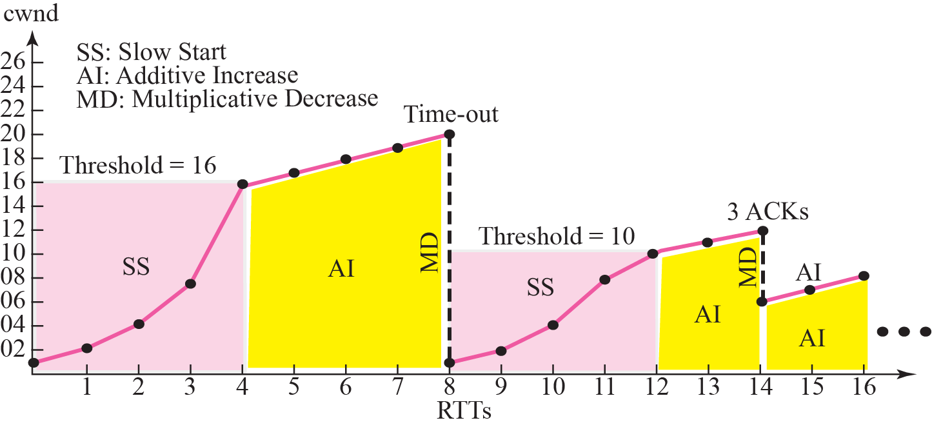
TCP Congestion Control
Fast Retransmit
(by Receiver)
Fast Recovery
(Sender cwnd)

Slide 37
Explicit Congestion Notification (ECN)
An example of explicit congestion signaling is the ECN capability provided in IP and TCP and defined in RFC 3168
IP header includes the 2-bit ECN field, which enables routers to indicate to end nodes packets that are experiencing congestion, without the necessity of immediately dropping such packets
A value of 00 indicates a packet that is not using ECN
As value of 01 or 10 is set by the data sender to indicate that the end-points of the transport protocol are ECN-capable
A value of 11 is set by a router to indicate congestion has been encountered
TCP header includes two one-bit flags:
ECN-Echo flag
CWR (congestion window reduced) flag
See the typical sequence of events on P678.
Notes:
An example of explicit congestion signaling is the explicit congestion notification
capability provided in IP and TCP and defined in RFC 3168. This mechanism was
first proposed in [FLOY94]. The IP header includes the 2-bit Explicit Congestion
Notification field, which enables routers to indicate to end nodes packets that are
experiencing congestion, without the necessity of immediately dropping such packets.
A value of 00 indicates a packet that is not using ECN. A value of 01 or 10
is set by the data sender to indicate that the end-points of the transport protocol
are ECN-capable. A value of 11 is set by a router to indicate congestion has been
encountered. The TCP header includes two one-bit flags: the ECN-Echo flag and
the CWR (congestion window reduced) flag. A typical sequence of events involving
all of these bits is as follows:
• The ECN field is set to 10 or 01 in packets transmitted by the sender to indicate
that ECN is supported by the transport entities for these packets.
• An ECN-capable router detects impending congestion and detects that an
ECN is set to 10 or 01 in the packet it is about to drop. Instead of dropping the
packet, the router chooses to set the field to 11 in the IP header and forwards
the packet.
• The receiver receives the packet with the 11 value set, and sets the ECN-Echo
flag in its next TCP ACK sent to the sender.
• The sender receives the TCP ACK with ECN-Echo set, and reacts to the congestion
as if a packet had been dropped.
• The sender sets the CWR flag in the TCP header of the next packet sent to
the receiver to acknowledge its receipt of and reaction to the ECN-Echo flag.
Typically, the reaction is to reduce the congestion window.

Slide 38
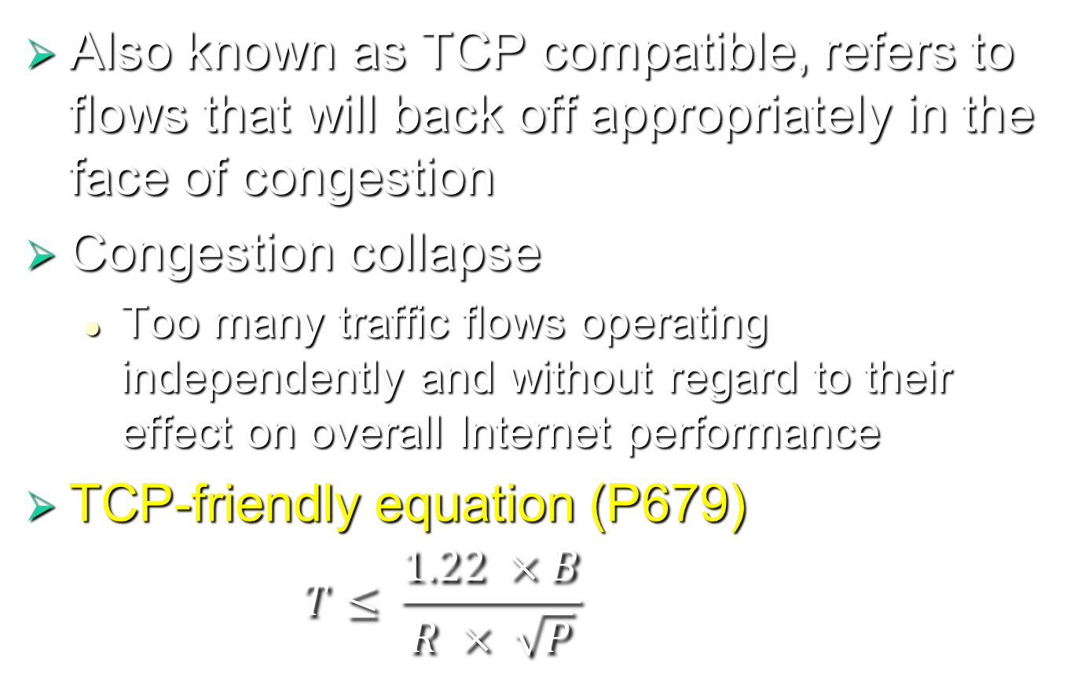
TCP Friendliness
Also known as TCP compatible, refers to flows that will back off appropriately in the face of congestion
Congestion collapse
  Too many traffic flows operating independently and without regard to their effect on overall Internet performance
TCP-friendly equation (P679)
  $$T≤ \frac{1.22 ×B}{R × \sqrt{P}}$$
Max pkt length
RTT
Pkt drop rate
Notes:
An important challenge for maintaining the usefulness of the Internet is for it to
be able to provide good service under heavy load. Even in the early days of the
Internet, it was realized that severe congestion could occur if there were too many
traffic flows operating independently and without regard to their effect on overall
Internet performance, a situation referred to as congestion collapse [NAGL84],
and illustrated in Figure 20.4. It was the phenomenon of congestion collapse that
led to the development of the elaborate set of TCP congestion control procedures
described in Section 20.5.
The TCP congestion control procedures do not support applications that do
not use TCP. With the ever-increasing load from multimedia applications, much of
the traffic on the Internet does not use TCP but rather use UDP or some other connectionless
protocol. These applications generally do not take into consideration
overall Internet congestion effects and hence can contribute to congestion collapse.
Thus, there has been an interest in developing a means of controlling data flows on
the Internet from such applications in a way that is TCP friendly . The term TCP
friendly, also known as TCP compatible, in rough terms refers to flows that will
back off appropriately in the face of congestion.

Slide 39
DCCP Operation
Datagram Congestion Control Protocol
Defined in RFC 4340
Connection-oriented
Runs on top of IP and serves as an alternative transport protocol for applications that would otherwise use UDP
Unreliable
No Retx.
Notes:
For multimedia applications, such as streaming audio or video, a reliable connection-
oriented transport protocol, such as TCP, is not appropriate for two reasons: It
imposes too much overhead and generally it is not desirable to delay the stream in
order to retransmit dropped packets. On the other hand, it is difficult to see how an
unreliable connectionless transport protocol, such as UDP, can detect and react to
congestion so as to conform to the TCP-friendly equation. Accordingly, the Internet
community has developed an unreliable connection-oriented protocol known as
Datagram Congestion Control Protocol (DCCP), defined in RFC 4340. Because
DCCP is connection-oriented, it can include mechanism for detecting congestion by
determining round-trip time and packet drop rates. Because DCCP is unreliable, it
does not include unwanted packet retransmission schemes.
DCCP runs on top of IP and serves as an alternative transport protocol for
applications that would otherwise use UDP.

Slide 40
DCCP Packet Types
DCCP-Request:
Sent by the client to initiate a connection (the first part of the three-way initiation handshake)
DCCP-Response:
Sent by the server in response to a DCCP-Request (the second part of the three-way initiation handshake)
DCCP-Data:
Used to transmit application data
DCCP-Ack:
Used to transmit pure acknowledgments
DCCP-DataAck:
Used to transmit application data with piggybacked acknowledgment information
DCCP-CloseReq:
Sent by the server to request that the client close the connection
DCCP-Close:
Used by the client or the server to close the connection; elicits a DCCP-Reset in response
DCCP-Reset:
Used to terminate the connection, either normally or abnormally
DCCP-Sync, DCCP-SyncAck:
Used to resynchronize sequence numbers after large bursts of loss
Notes:
DCCP consists of the following ten
packet types:
• DCCP-Request: Sent by the client to initiate a connection (the first part of the
three-way initiation handshake).
• DCCP-Response: Sent by the server in response to a DCCP-Request (the second
part of the three-way initiation handshake).
• DCCP-Data: Used to transmit application data.
• DCCP-Ack: Used to transmit pure acknowledgments. That is, this packet is
sent by one end of the connection to acknowledge an incoming data packet
when there is no data packet available to send back.
• DCCP-DataAck: Used to transmit application data with piggybacked acknowledgment
information.
• DCCP-CloseReq: Sent by the server to request that the client close the
connection.
• DCCP-Close: Used by the client or the server to close the connection; elicits a
DCCP-Reset in response.
• DCCP-Reset: Used to terminate the connection, either normally or abnormally.
• DCCP-Sync, DCCP-SyncAck: Used to resynchronize sequence numbers after
large bursts of loss.

Slide 41
Notes:
Figure 20.11 shows the normal exchange between two DCCP users. First, the
two users must establish a logical full-duplex connection. This phase also includes
a negotiation of options, such as which congestion control mechanism to use.
Following this is a data transfer phase, in which each side can send data and each side
must acknowledge incoming data. For this purpose each data and acknowledgment
packet carries a sequence number that is incremented by one per packet. Finally,
either side may terminate that connection. Note that both the initiation and termination
phases involve three-way handshakes.
A single sequence number is maintained in each direction for all ten types of
packets
The first two lines show that A sends two packets to B, numbered 1 and 2. Then
B sends a pure acknowledgment with a sequence number of 10 and an acknowledgment
of the last received packet. With A’s next data packet, it increments its
own sequence number and acknowledges the last packed from B by including an
acknowledgment number. B’s next packet is a data packet with a sequence number
and an acknowledgment number. The use of a single sequence numbering scheme
for all three types of packets enables the endpoints to detect all packet loss, including
acknowledgment loss.
Since DCCP provides unreliable semantics, there are no retransmissions, and
having a TCP-style cumulative acknowledgment field doesn’t make sense. DCCP’s
Acknowledgment Number field equals the greatest sequence number received,
rather than the smallest sequence number not received. Separate options may be
used to indicate any intermediate sequence numbers that weren’t received.
If a network outage or large burst of dropped packets occurs, the two endpoints
will receive sequence numbers and acknowledgment numbers very different
from what was expected. This could complicate some of the congestion control mechanisms
employed with DCCP. To bring the endpoints back into synchronization, an
endpoint receiving an unexpected sequence or acknowledgment number sends a
Sync packet asking its partner to validate that sequence number. The other endpoint
processes the Sync and replies with a SyncAck packet. When the original endpoint
receives a SyncAck with a valid ackno, it updates its expected sequence number
windows based on that SyncAck’sseqno.

Slide 42
Notes:
Figure 20.12 shows the overall format of a DCCP packet. Every packet includes a
generic header, which consists of the following fields:
• Source and Destination Ports (16 bits each): These fields identify the connection,
similar to the corresponding fields in TCP and UDP.
• Data Offset (8 bits): The offset from the start of the packet’s DCCP header to
the start of its application data area, in 32-bit words.
• CCVal (4 bits): Reserved for use by the sender’s congestion control mechanism.
That is, it can be used by a congestion control mechanism to encode up
to 4 bits of information in the generic header.
• Checksum Coverage (CsCov) (4 bits): Checksum Coverage determines the
parts of the packet that are covered by the Checksum field. This always
includes the DCCP header and options, but some or all of the application data
may be excluded. This can improve performance on noisy links for applications
that can tolerate corruption.
• Checksum (16 bits): The Internet checksum of the packet’s DCCP header
(including options), a network-layer pseudoheader, and, depending on
Checksum Coverage, all, some, or none of the application data.
• Reserved (Res) (3 bits): Not used.
• Type (4 bits): Specifies the type of the packet.
• Extended Sequence Numbers (X) (1 bit): Set to one to indicate the use of
an extended generic header with 48-bit Sequence and Acknowledgment
Numbers. Figure 20.12 shows the format for X = 1.
• Reserved (8 bits): Not used is X = 1. This field is not present for X = 0, so
that the 24-bit sequence number can be accommodated without an additional
32-bit word.
• Sequence Number (48 or 24 bits): Identifies the packet uniquely in the
sequence of all packets the source sent on this connection. Sequence Number
increases by one with every packet sent, including packets such as DCCP-Ack
that carry no application data.
Connection initiation, synchronization, and teardown packets must use 48-bit
sequence numbers. This ensures that the endpoints agree on sequence number and
reduces the probability of success of some types of attacks. The 24-bit sequence
number is simply the lower 24 bits of the sequence number and should suffice in
most cases, providing greater efficiency in the transfer of data packets.
Following the generic header is the acknowledgment subheader, which contains
the 24- or 48-bit acknowledgment number. All packets include this header
except DCCP-Request and DCCP-Data. Allowing for DCCP-Data packets without
including an acknowledgment number enables a data-intense user, such as a video
stream, to transmit with the minimum of overhead.
The remainder of the packet includes additional fields required by various
packet types, optional data for various functions, and optional application data.

Slide 43
DCCP Congestion Control
The Internet DCCP Working Group has defined two congestion control mechanisms, each assigned a congestion control identifier (CCID):
TCP-like congestion control (CCID 2)
This mechanism has behavior modeled directly on TCP, including congestion window, slow start, and time-outs
Applications should use CCID 2 if they prefer maximum bandwidth utilization to steadiness of rate
TCP-friendly rate control (TFDC) (CCID 3)
This mechanism is based on the use of a variant of the TCP-friendly equation
Suitable for applications such as streaming media, where a relatively smooth sending rate is important
Notes:
As with TCP, DCCP is a transport-layer protocol that defines the mechanisms and
formats for connection establishment, data transfer, and connection termination but
does not directly specify congestion control mechanisms. The DCCP packet format
is sufficiently flexible to be able to support a variety of congestion control regimes.
Accordingly, the Internet DCCP Working Group has defined two congestion control
mechanisms, each assigned a congestion control identifier (CCID), and will
define further mechanisms in the future. The two mechanisms so far defined are:
• TCP-like congestion control (CCID 2): This mechanism has behavior modeled
directly on TCP, including congestion window, slow start, and time-outs.
CCID 2 achieves maximum bandwidth over the long term, consistent with
the use of end-to-end congestion control, but halves its congestion window in
response to each congestion event. This leads to the abrupt rate changes typical
of TCP. Applications should use CCID 2 if they prefer maximum bandwidth
utilization to steadiness of rate. This is often the case for applications
that are not streaming their data directly to the user.
• TCP-friendly rate control (TFDC) (CCID 3): This mechanism is based on
the use of a variant of the TCP-friendly equation (Equation 20.8). TFRC is
designed to be reasonably fair when competing for bandwidth with TCP-like
flows, where a flow is “reasonably fair” if its sending rate is generally within
a factor of two of the sending rate of a TCP flow under the same conditions.
However, TFRC has a much lower variation of throughput over time compared
with TCP, which makes CCID 3 more suitable than CCID 2 for applications
such as streaming media, where a relatively smooth sending rate is important.
A CCID-compliant implementation must implement the appropriate congestion
control algorithms and must include the appropriate fields and optional information
in the DDCP packets. For example, TFRC requires that data senders attach
to each data packet a coarse-grained “timestamp” that increments every quarter
round-trip time. This timestamp allows the receiver to group losses and marks that
occurred during the same round-trip time into a single congestion event.

Slide 44

Summary
Effects of congestion
  Ideal performance
  Practical performance
Congestion control
  Backpressure
  Choke packet
  Implicit and explicit congestion signaling
Traffic management
  Fairness
  Quality of service
  Reservations
  Traffic shaping and policing
Congestion control in packet-switching networks
TCP congestion control
  Retransmission timer management
  Window management
  Explicit congestion notification
Datagram congestion control protocol
  TCP friendliness
  DCCP operation
  DCCP packet format
  DCCP congestion control
Notes:
Chapter 20 summary.

