Slide 1
Data and Computer Communications
Tenth Edition
by William Stallings
Notes:
“Data and Computer Communications”, 10/e, by William Stallings, Chapter 16 “Advanced Data Communications Topics”.

Slide 2
Advanced Data Communications Topics
Chapter 16
16.3 ARQ Performance Issues
Notes:
In this chapter, we examine three data communications topics referenced in
Unit One, but which require a more advanced mathematical treatment. First,
we complete the discussion of signal encoding techniques begun in Chapter 5,
by discussing the use of analog signals to transmit analog data. Next, we elaborate
on the discussion in Chapter 6 on forward error correction by looking
at specific algorithms. Finally, the chapter examines some LAN performance
issues.

Slide 3
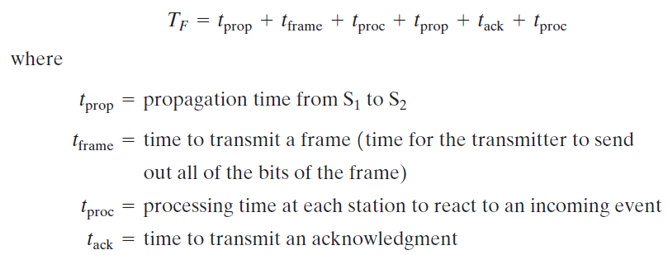
Stop-and-Wait Flow Control
Calculation of the max. potential efficiency
T_{F} is the time to send one frame and receive an acknowledgment

Slide 4
Assume t_{proc} and t_{ack} are negligible
The total time to send n frames (T)
The utilization of the line (U)

Slide 5
The propagation time is equal to the distance d of the link divided by the velocity of propagation V.
For unguided transmission through air or space, V is the speed of light
For guided transmission, V is approximately 0.67 times the speed of light for optical fiber and copper media.
The transmission time is equal to the length of the frame in bits, L, divided by the data rate R.
For fixed-length frames, a is proportional to the data rate times the length of the
medium.

Slide 6
Notes:
Figure 16.8 Stop-and-Wait Link Utilization

Slide 7
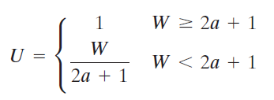
Error-Free Sliding-Window Flow Ctrl
The throughput on the line depends on both the window size W and the value of a.
For convenience, normalize frame transmission time to a value of 1; thus, the propagation time is a.
Also assume t_{proc} and t_{ack} are negligible

Slide 8
Notes:
Figure 16.9 illustrates
the efficiency of a full-duplex point-to-point line

Slide 9
Notes:
Figure 16.10 Sliding-Window Utilization as a Function of a

Slide 10
Stop-and-Wait ARQ
If errors occur,

Slide 11
Calculation of N_{r}

Slide 12
Selective-Reject ARQ

Slide 13
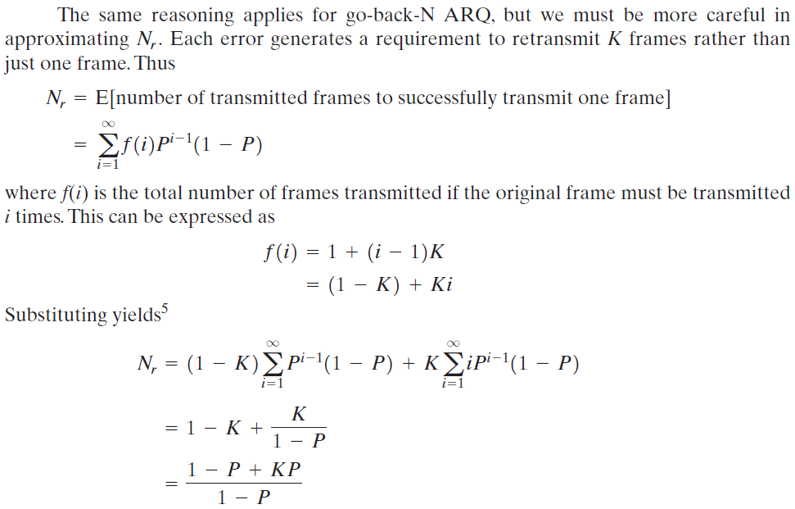
Go-Back-N ARQ

Slide 14
Note that for W = 1, both Selective-Reject and Go-Back-N ARQ reduce to Stop-and-Wait.

Slide 15
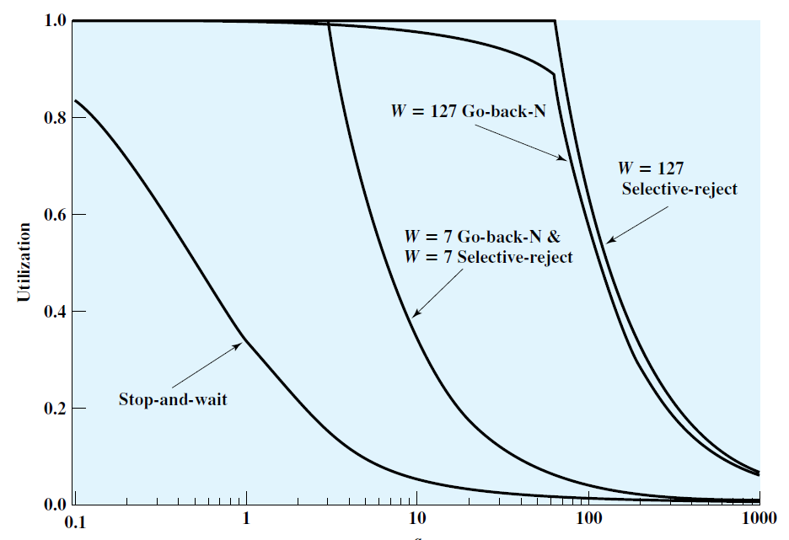
Notes:
Figure 16.11 ARQ Utilization as a Function of a (P = 10⁻³)

Slide 16
Summary
Analog data, analog signals
Amplitude modulation
Angle modulation
ARQ performance issues
Stop-and-wait flow control
Error-free sliding-window flow control
ARQ
Forward error-correcting codes
Cyclic codes
BCH codes
Reed-Solomon codes
Parity-check matrix codes
Low-density parity-check codes
Notes:
Chapter 16 summary.

